Slide 1

Chapter/Unit 2
Organizational Strategy, Competitive Advantage, and Information Systems

Slide 2
Learning Objectives:
Identify various business pressures that affect organizations in the digital age.
Identify effective IT responses to different kinds of business pressures.
Describe strategic IS and Porter’s five competitive forces.
Describe the strategies that organizations typically adopt to counter Porter’s five competitive forces.

Slide 3
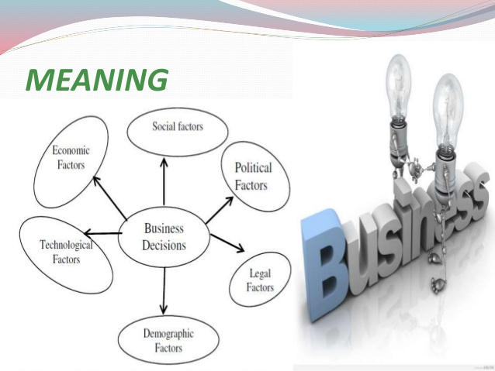
Several Terms
Business Environment: The combination of social, legal, economic, physical, and political factors in which businesses operate.

Slide 4

Several Terms
Business Environment: The combination of social, legal, economic, physical, and political factors in which businesses operate.
Significant changes in any of these factors are likely to create Business Pressures on organizations.

Slide 5
Several Terms
Strategic systems
Customer focus
Make-to-order
Mass customization
E-business
E-commerce
……
Organizations Responses with IS
Competitive Advantage: Any assets that provide an organization with edges against its competitors. For example:
Cost
Quality
Speed
Market control
Larger-than-average profits
……

Slide 6
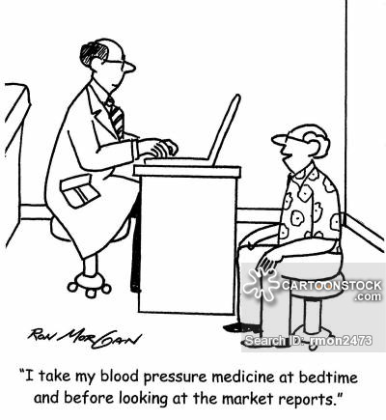
Types of Business Pressures
Market Pressures: Business pressures generated by:
Global economy (Globalization)
Intense competition
Changing nature of workforce: Diversified workforce
Powerful customers: Customers (informed users) become more knowledgeable about the products and services
……

Slide 7

Types of Business Pressures
Technology Pressures: Business pressures caused by
Technological innovation and obsolescence: Legacy vs. Cutting edge
Information overload: End users must be able to access, navigate, and utilize vast stores of data, information, and knowledge.

Slide 8

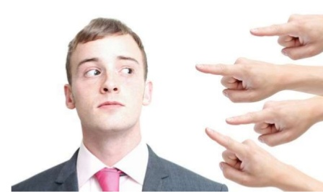
Types of Business Pressures
Societal/Political/Legal Pressures: Business pressures related to:
Social responsibility: Physical environment, philanthropy, education, social problems, and more...
Government regulation and deregulation regarding health, safety, environmental protection, equal opportunity…
Spending for social programs.
Spending to protect against terrorism.
Ethics: e.g., standards of right and wrong in information processing practices.

Slide 9
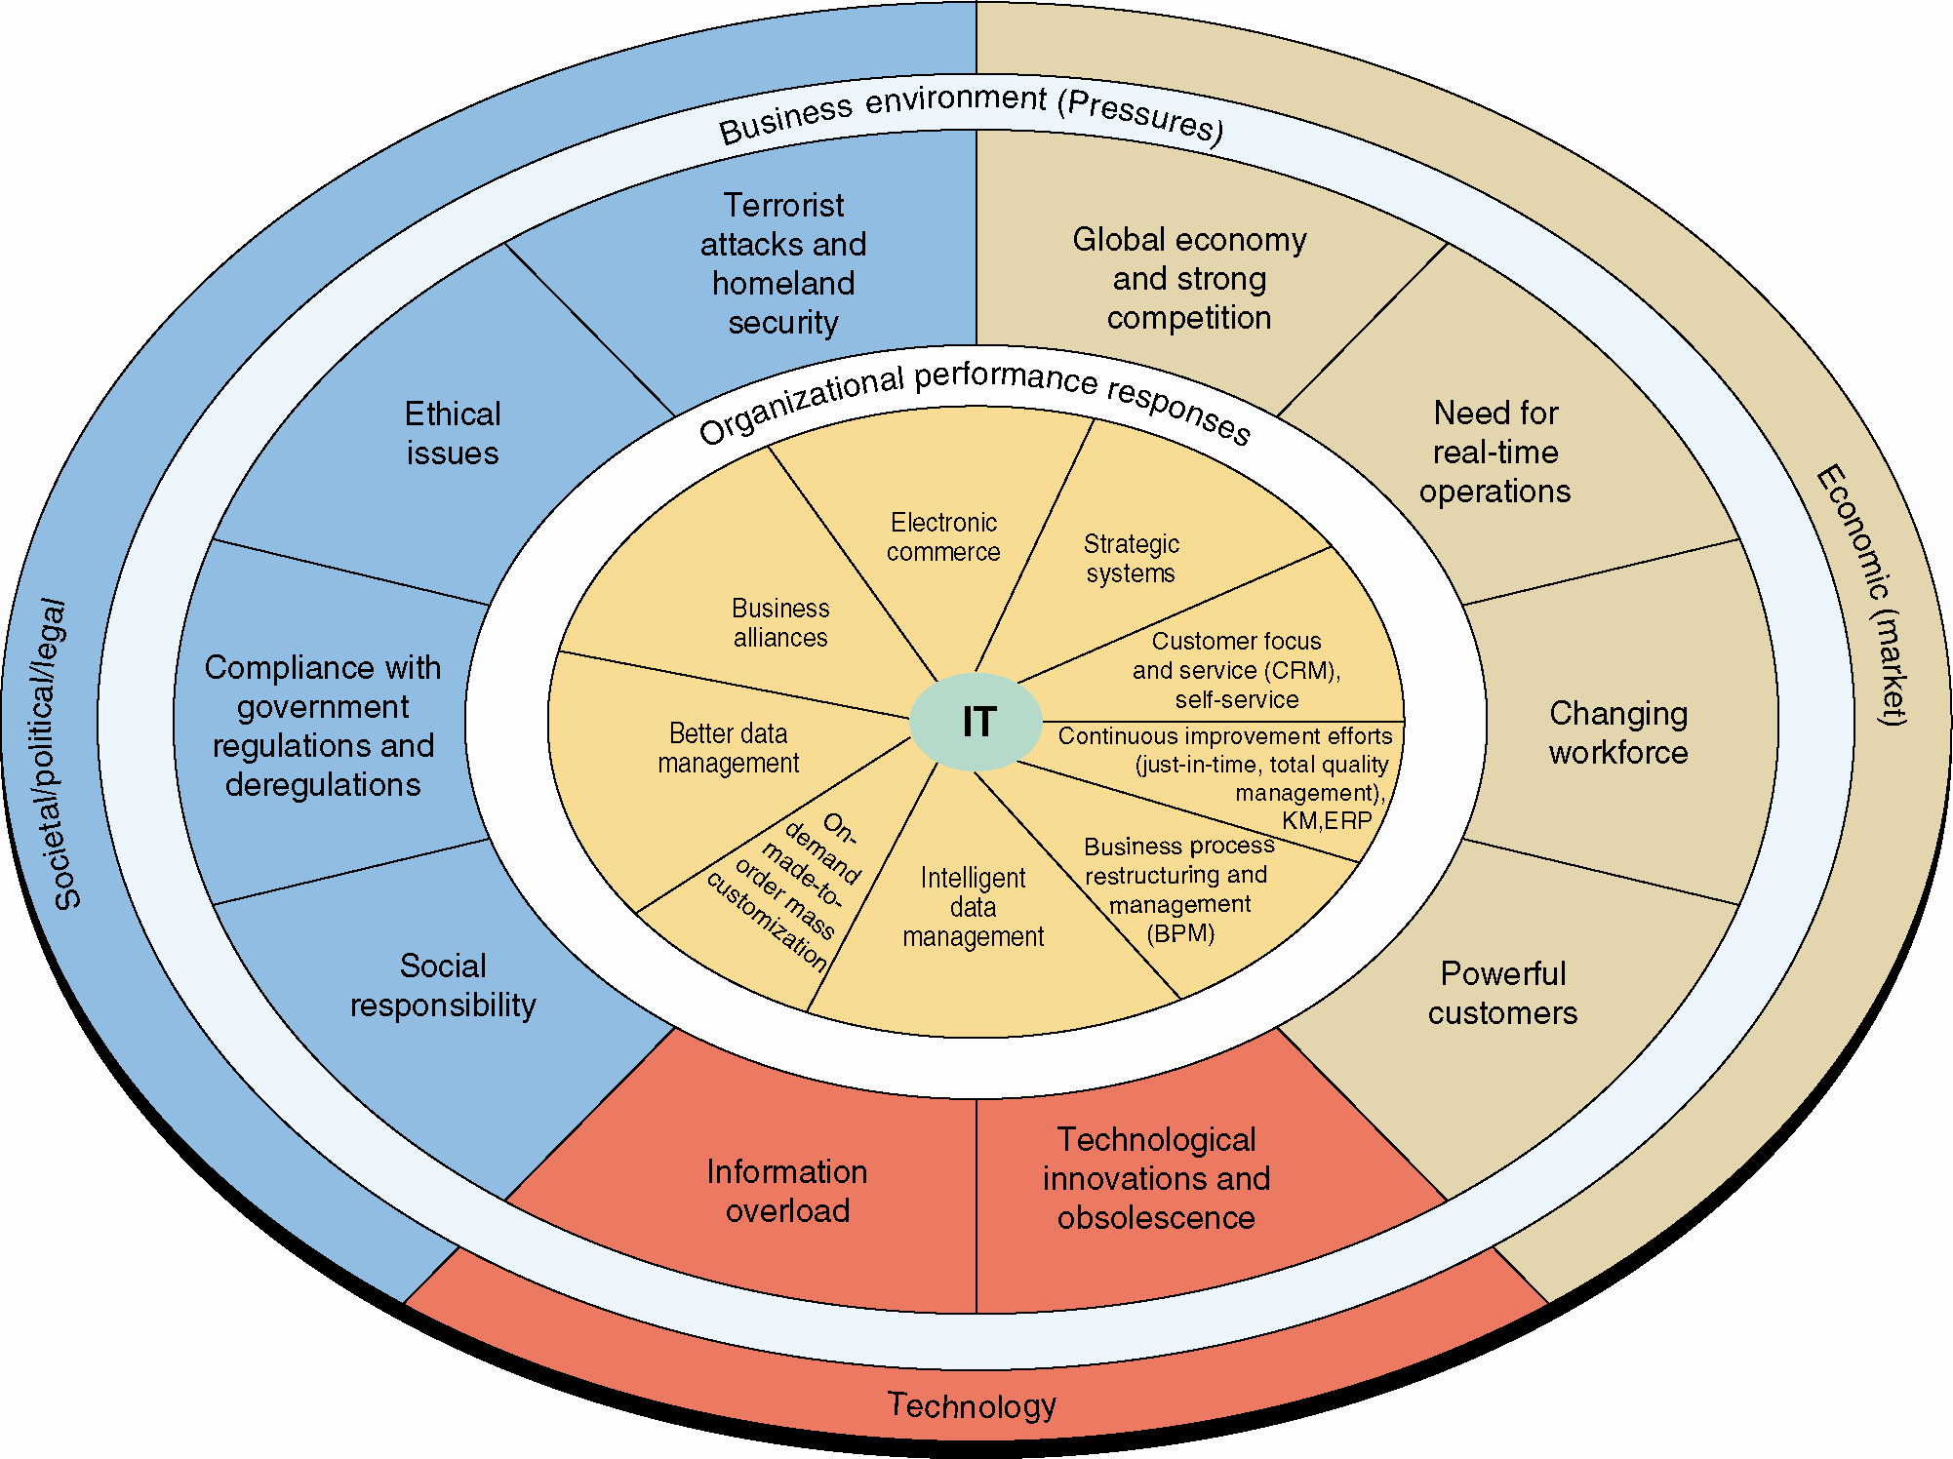
Business Pressures, Organizational Performance & Responses and IT Support

Slide 10

Organizational Responses
Strategic Systems: provide organizations with advantages to:
Increase market share and/or profits.
Better negotiate with suppliers.
Prevent competitors from entering markets.
Strategic IS.

Slide 11

Organizational Responses
Customer Focus: provide superb customer service that can make the difference between attracting and retaining customers.
For examples, IT tools and business processes to keep customers happy.

Slide 12
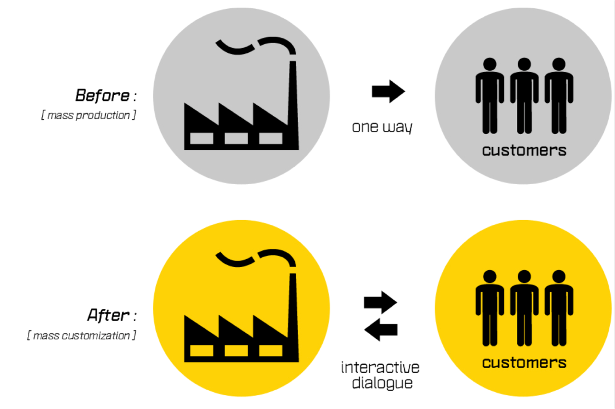
Organizational Responses
Make-to-Order: Producing customized (made to individual specifications) products and services.
Mass Customization: Producing a large quantity of items, but it customizes them to match the needs and preferences of individual customers.
Notes:
Mass customization is essentially an attempt to perform make-to-order on a large scale.

Slide 13
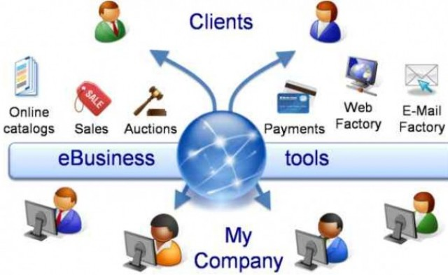
Organizational Responses
Electronic commerce: The process of buying, selling, transferring, or exchanging products, services, or information via computer networks, e.g., the Internet.
Electronic business: A broader concept servicing customers, collaborating with business partners, and performing electronic transactions within an organization.

Slide 14
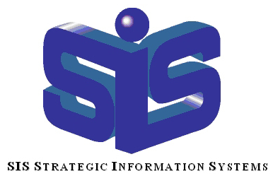
Competitive Advantage & Strategic IS
Strategic Information Systems: IS that help an organization implement its strategic goals and improve performance and productivity.
Competitive Advantage: Any assets that provide an organization with edges against its competitors. For example:
Cost
Quality
Speed
Market control
Larger-than-average profits
……

Slide 15
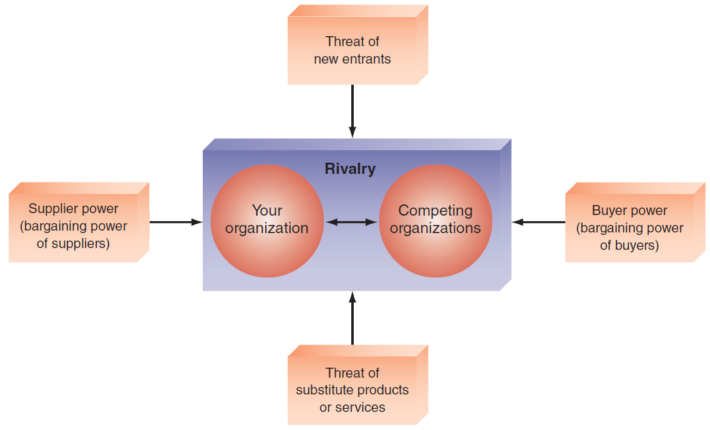
Competitive Advantage & Strategic IS
- Porter’s Competitive Forces Model
The threat from rivalry is high when there is intense competition among many firms in an industry. The threat is low when the competition is among fewer firms and is not as intense.
The threat that new competitors will enter the market is high when entry is easy; and low when there are significant barriers to entry.
Supplier power is high when buyers have few choices from whom to buy; and low when buyers have many choices.
Buyer power is high when buyers have many choices from whom to buy; and low when buyers have few choices.
Barrier to Entry: a product or service feature that customers expect from organizations.
Switching Costs: the costs, in money and time, imposed by a decision to buy elsewhere (e.g., contracts with smartphone providers).
If there are many alternatives to an organization’s products or services, then the threat of substitutes is high. If there are few alternatives, then the threat is low.
Notes:
Barrier to Entry: a product or service feature that customers have learned to expect from organizations in a certain industry. A competing organization must offer this feature in order to survive in the marketplace (e.g., legal requirements such as admission to the bar to practice law).
Switching Costs: the costs, in money and time, imposed by a decision to buy elsewhere (e.g., contracts with smartphone providers).

Slide 16
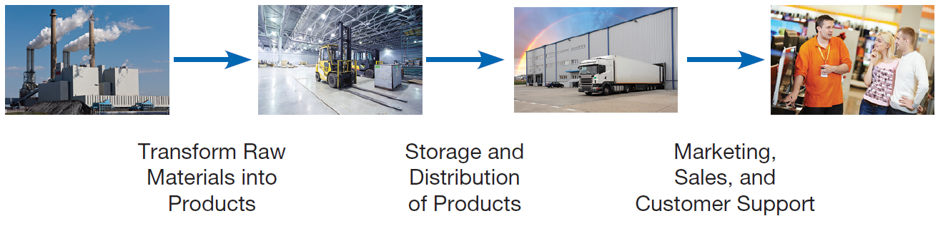
Competitive Advantage & Strategic IS
- Porter’s Value Chain Model
Value Chain: A sequence of activities through which the organization’s inputs are transformed into more valuable outputs.
Value System: Includes the suppliers that provide the inputs necessary to the firm along with their value chains. After the firm creates products, these products pass through the value chains of distributors (which also have their own value chains), all the way to the customers.
Notes:
This is a picture of the value chain. It’s all about input, processing, and output, as you can see. Each phase of the value chain involves some business unit(s) of the organization. An information system will address the need of some element(s) of the value chain.

Slide 17
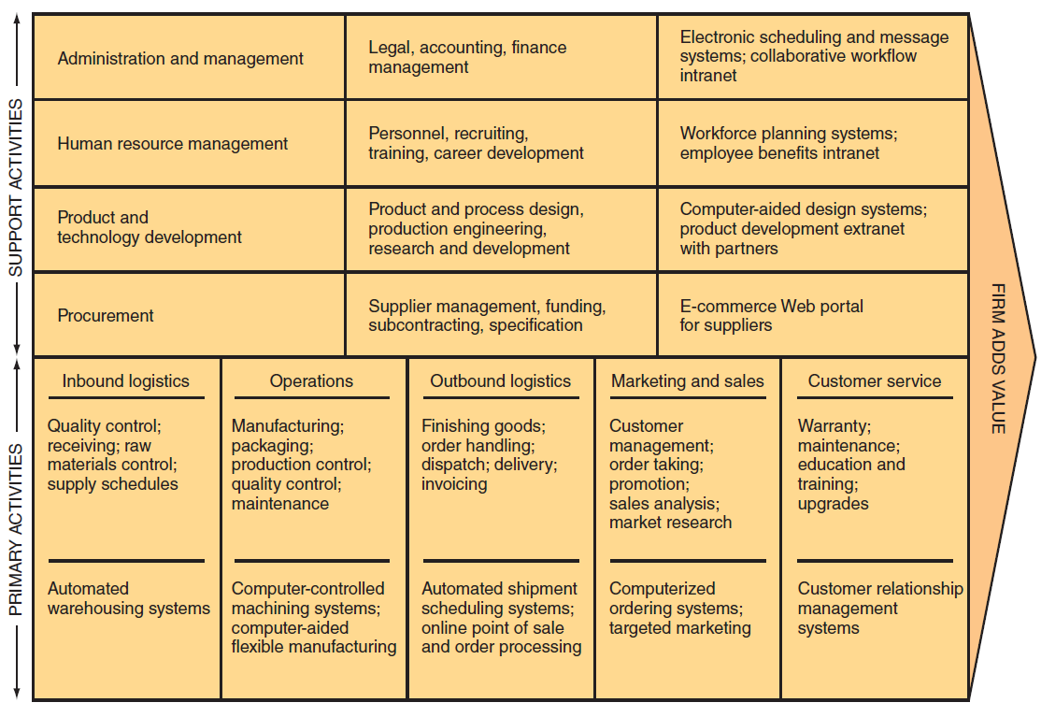
Competitive Advantage & Strategic IS
- Porter’s Value Chain Model
Value Chain: A sequence of activities through which the organization’s inputs are transformed into more valuable outputs.
Value System: Includes the suppliers that provide the inputs necessary to the firm along with their value chains. After the firm creates products, these products pass through the value chains of distributors (which also have their own value chains), all the way to the customers.
Support activities: Support the primary activities, but do not add value directly to the firm’s products or services.
The firm’s infrastructure (accounting, finance, management)
Human resources management
Product and technology development
Procurement
Primary Activities: relate to the production and distribution of the firm’s products and services. These activities create value for which customers are willing to pay.
Inbound logistics (inputs)
Operations (manufacturing and testing)
Outbound logistics (storage and distribution)
Marketing and sales
Services

Slide 18
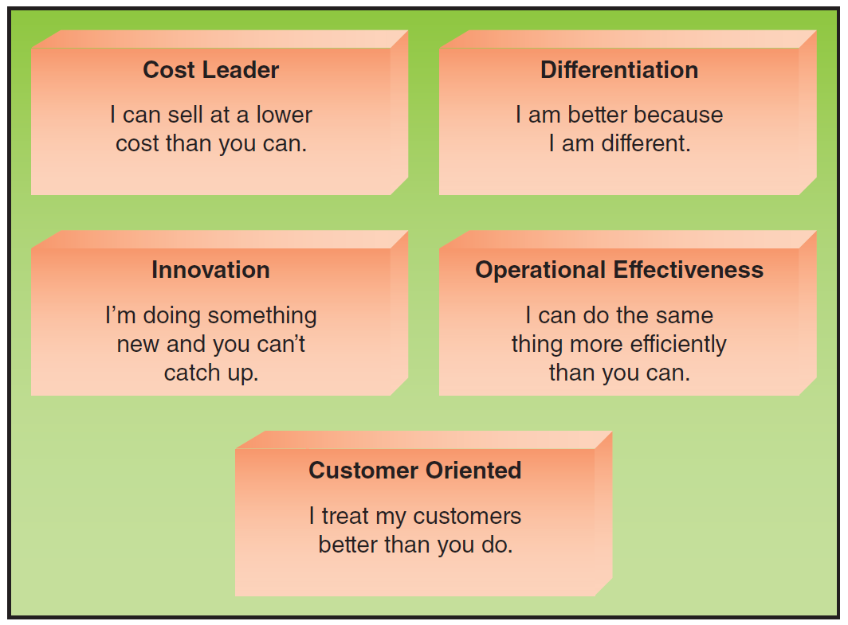
Competitive Advantage & Strategic IS
- Strategies for Competitive Advantage
Cost leadership strategy: Produce products and/or services at the lowest cost in the industry.
Differentiation Strategy: Offering different products, services, or product features than competitors.
Innovation Strategy: Introduce new products and services, add new features to existing products and services, or develop new ways to produce them .
Operational Effectiveness Strategy: A firm performs business activities more effectively than its rivals.
Customer Orientation Strategy: Concentrate on making customers happy.
Notes:
Competitive Advantage Strategies:
Cost leadership strategy: Produce products and/or services at the lowest cost in the industry (e.g., Walmart’s automatic inventory replenishment system).
Differentiation Strategy: Offering different products, services, or product features than your competitors (e.g., Southwest Airlines has differentiated itself as a low-cost, short-haul, express airline).
Innovation Strategy: Introduce new products and services, add new features to existing products and services, or develop new ways to produce them (Classic Example: the first introduction of automated teller machines (ATMs) by Citibank).
Operational Effectiveness Strategy: Improve the manner in which a firm executes its internal business processes so that it performs these activities more effectively than its rivals. Such improvements increase quality, productivity, and employee and customer satisfaction while decreasing time to market.
Customer Orientation Strategy: Concentrate on making customers happy. Web-based systems are particularly effective in this area because they can create a personalized, one-to-one relationship with each customer.

Slide 19
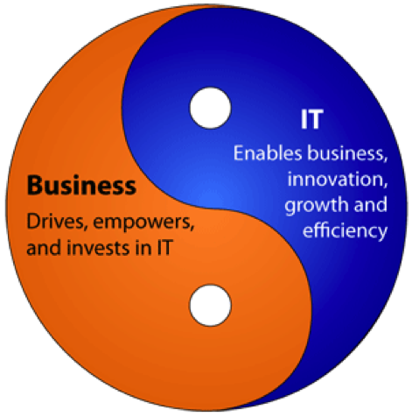
Competitive Advantage & Strategic IS
- Business – IT Alignment
Business – IT Alignment: IT functions directly support business objectives through the tight integration of IT functions with the organization’s strategy, mission, and goals.

Slide 20
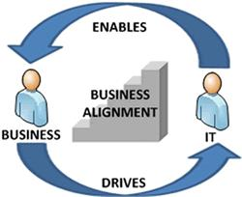
6 Characteristics: Excellent Business-IT Alignment
1. The organization views IT as an engine of innovation that continually transforms the business, often creating new revenue streams.
2. The organization views its internal & external customers & their customer service functions as supremely important.

Slide 21

6 Characteristics: Excellent Business-IT Alignment
3. The organization rotates business & IT professionals across departments and job functions.
4. The organization provides overarching goals that are completely clear to IT and business employees.

Slide 22

6 Characteristics: Excellent Business-IT Alignment
5. The organization ensures that IT employees understand how the company operates.
6. The organization creates a vibrant and inclusive company culture.

Slide 23
Summary:
Identify various business pressures that affect organizations.
Identify effective IT responses to different kinds of business pressures.
Describe strategic IS and Porter’s five competitive forces.
Describe the strategies that an organization typically adopts to counter Porter’s five competitive forces.

